Slide 1
The Perfect Bridge for Joining West Africa
The Perfect Bridge for Joining West Africa
Shipping agency – Stevedoring – Forwarding -Transport
Taking the lead in a world of change
AMARYS- LOGISTICS & SUPPLY CHAIN SOLUTIONS
ALSC – IVORY COAST
(ABIDJAN - SAN PEDRO)
AMARYS- LOGISTICS & SUPPLY CHAIN SOLUTIONS
ALSC – IVORY COAST
(ABIDJAN - SAN PEDRO)

Slide 2
Table of Content
Our Vision And Values
Office Locations
Compliance
Our Services
Our Slogan
Contacts

Slide 3
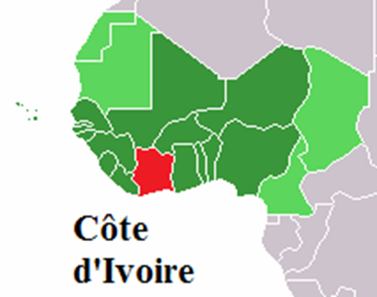
Our Vision And Values
Safety We provide a safe working environment and demand safe behaviour from our employees. We are committed to a strong safety culture.
Quality We meet high standards of quality in both what we do and how we deliver it. We take pride in our products and our service excellence.
Integrity We value professional and personal integrity. We achieve our goals by being honest and straight forward with our clients, employees and investors.

Slide 4
Our Vision And Values
At International Shipping Service Côte d’Ivoire, we strive to provide the best and most cost-efficient services, to our clients benefit and satisfaction.
Our core values are centred on:
Ethics: International Shipping Service is committed to a strong ethical policy and standard in any action, In compliance with existing anti-corruption laws. International Shipping Service has adopted and implemented a comprehensive anti-corruption policy and strong compliance program.
Performance: International Shipping Service aims at providing the best cost-effective services in due time and true and consistent professionalism.
Integrity: We treat everyone involved in the organization - staff, stakeholders, and customers alike - with dignity and respect. We are truthful and candid and endeavour to keep our promises and deliver on our commitments.
Commitment: We are committed to creating a culture that values individual and collective energy, spirit, leadership, creativity and innovation.
Excellence : In everything that we do, we search for excellence and continuous improvement to ensure client satisfaction and business success.

Slide 5
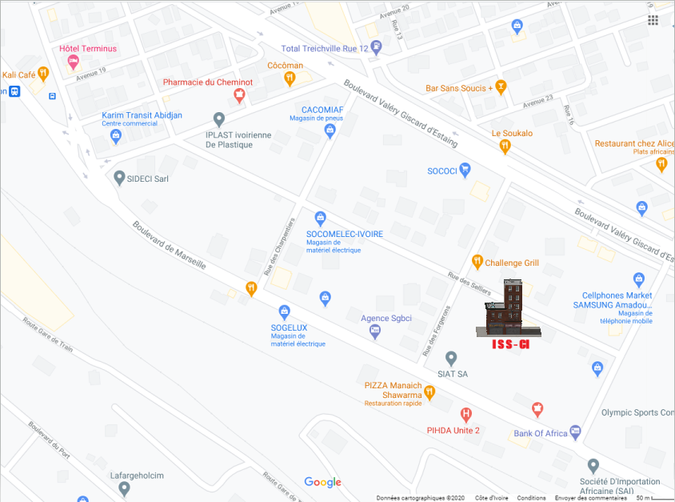
Offices Location - Abidjan

Slide 6
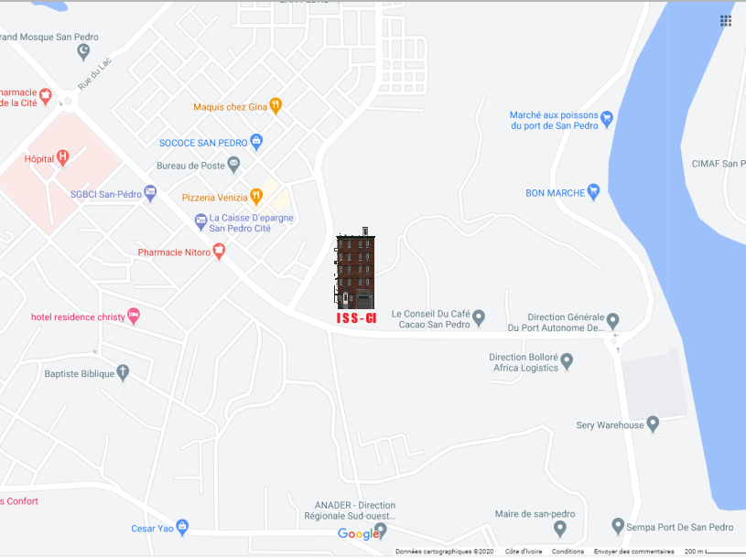
Offices Location – San Pedro

Slide 7
Compliance
International Shipping Service is strongly committed to upholding ethical standards in all its affairs and to promoting compliance with the anti-corruption laws where we conduct business, including but not limited to, the U.S. Foreign Corrupt Practices Act, and the UK Bribery Act 2010.
International Shipping Service expects all its employees and third-parties engaged to act on its behalf to comply with its Policy Against Bribery.
International Shipping Service believes in integrity, transparency and constant communication with its customers on this subject and will endeavor, in cooperation with its customers, to detect and prevent corruption within its operations.

Slide 8
Our Services
SHIPPING AGENCY (Abidjan & San Pedro)
International Shipping Service operates in Six main business
Freight forwarding, including customs clearance
Ship Agency
Husbandry (Meet & Greet)
Stevedoring
Logistics
Transport

Slide 9
Our Services
FREIGHT FORWARDING
Through our local freight forwarding network (Air freight/Sea freight) International Shipping Service is able to:
Arrange freight forwarding shipments from or to any locations in the world and negotiate best rates by sea or air.
Coordinate traditional or project-based freight forwarding, along with customs clearance at departure and destination points
Warehousing of all types of cargoes as well as oil & gas equipment
International Shipping Service is fully independent and has therefore developed the best working relations with the customs brokers and freight forwarders selected by our clients to ensure a smooth handling of the shipments throughout the transportation chain
International Shipping Service’s goal is to offer simplified transparent & comprehensive tariffs as well as easy operational solutions to its clients

Slide 10
Our Services
SHIP AGENCY (Including Stevedoring, Logistics and Transport)
(Regular Line, Tramp, Tankers, Offshore Vessels )
Audit Focus for Ships Agency:
Adherence to a Standard of Operation (SOO and SOF)
Auditing and Quality Assessment of Service Providers
Husbandry services: 100% service provided in safety conditions.
Procurement services: Minimum 2 or 3 suppliers offer Pro forma Invoices which must be presented for Customer approval before operating.
Crew Change services: 100% operated in timely and in perfect safety conditions.
QHSSE Target:
Arrival response Time:
Time from moored time to arrival report sent: 3 Hours
Daily Activity Report with 100% accuracy: 2 times per day
Departure Response Time:
Time from last Line Off time to Departure report sent): 3 Hours
Global Implementation of “Vessel Transfer Procedure” : 100%
Global Implementation of “Land Transportation of Personnel Procedure”: 100%

Slide 11
Our Services
HUSBANDRY SERVICES
International Shipping Service understands the importance of taking care of people and has developed a personalized service that provides full assistance to personnel and crew members, it assists with all aspects of travel and accommodation:
Airport Meet & Greet – experienced airport and port agents
Visas – International Shipping Service is able to provide pre-arrival visas in record time, thanks to its excellent relationship with local authorities
Purchasing Air tickets – Partnership with well-established travel Agents
Hotels – Commercial deals with reputable hotels in Abidjan
Crew transfers – International Shipping Service chooses its suppliersand partners according to strict QHSE standards

Slide 12
Our Services
CUSTOMS CLEARANCE
International Shipping Service puts great emphasis on the efficiency of the clearing process by:
Monitoring the clearing procedures with high ethical standards in coordination with customs and ensuring fast & effective clearance
Assisting its clients with the pre-shipment inspection process and the documentation issuance & obtention
Maintaining day-to-day control on the clearing process, making sure that no decisions are made without the prior validation of our Transit Management.

Slide 13
Our Slogan
Thinking Logistics in West Africa
International Shipping Service, your local Partner:
Newly founded International Shipping Service office in Abidjan and San Pedro are exclusively managed and run by local personnel who are duly qualified and experienced.
We believe that International Shipping Service’s future success in West Africa is based the fact that 100% of our Local Agents are fully trained with full management team support.
Social knowledge, local know-how and the right professional connections are the key to success and future development, our goal is our customer’s satisfaction.
With Standardized processes and IT systems, all our personnel are driven by the same Aim:
To Be Customer Centered

Slide 14
Contacts
International Shipping Service Côte d’Ivoire
Abidjan, Treichville, Zone 2 Rue des selliers,
Immeuble Doukouré, 1er étage
Office Phone: +225 2721 240 292
Mobile Phone: +225 0707 305 998
+225 0708 479 974
PIC: Norbert ANEYE
Email: infos@iss-ci.net
norbert.aneye@iss-ci.net
developpement@iss-ci.net

Slide 15
We connect you to West Africa
Integrity - Independence - Efficiency - Excellence

